Slide 1
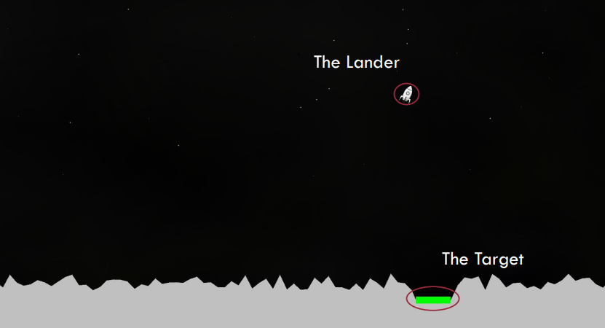
Multi Layer Perceptron
-
Lunar Lander Game
Ishita Agarwal
2201110

Slide 2
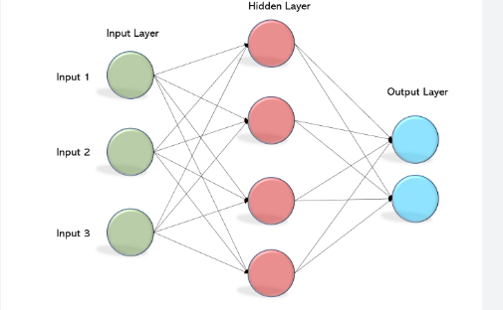
Architecture design
Multi layer perceptron (MLP) is a supplement of feed forward neural network.
The most important thing is to be able to represent the architecture of 3 layers (input, hidden and output) and N number of neurons per layer.
Multilayer Perceptrons are widely used to solve problems requiring supervised learning and research into computational neuroscience and parallel distributed processing. Examples include speech recognition, image recognition, and machine translation.
The Multilayer Perceptron is a deep learning method that uses backpropagation to train the network.

Slide 3
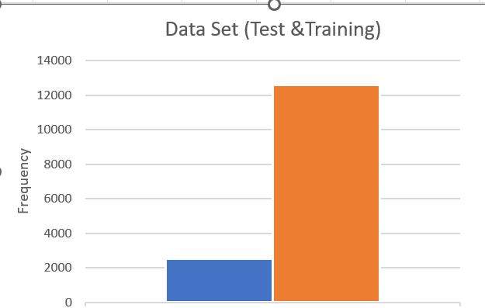
Steps Involved
OBJECTIVE
Play the game and collected the data .
Partitioning the data
Divided the Training and Test data in ratio 80:20
Processing the data
Removed all the inconsistencies from the data
Normalized the data in ratio 0-1

Slide 4
Design Choice
Variables
• Inputs
• Hidden Nodes
• Output Nodes
• Output Weights
• Delta Weights
• Hidden gradients Functions:
• Activation
Functions Used
•Feed Forward
Derivative of Activation Functions
• Weight Update
• Backpropagation
• Error Calculation
Updating Delta weights
Stopping Criteria
Tools Used:
MATLAB:
NNTOOLS package :The neural network toolbox provides functions and apps for modelling complex nonlinear systems that are not easily modelled with a closed-form equation. The toolbox supports supervised learning with feed forward, radial basis, With the toolbox you can design, train, visualise, and simulate neural networks.
PYTHON:
A python list to save multiple neurons and represent a layer

Slide 5
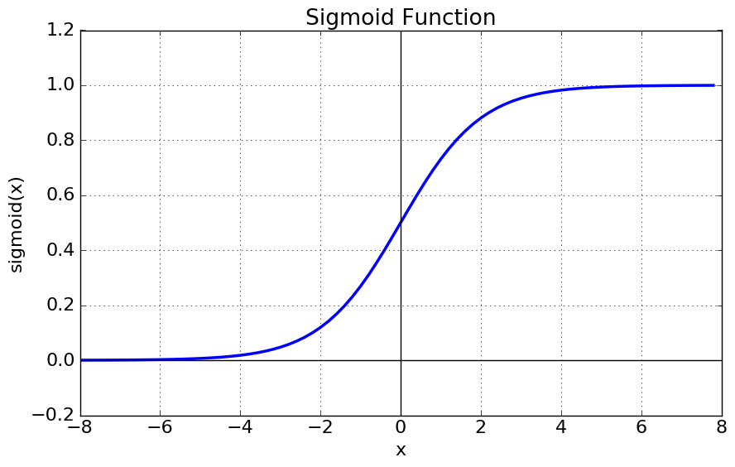
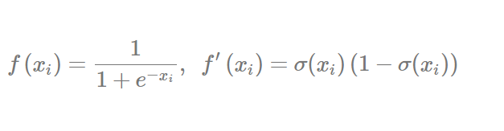
Choice of Activation Function-The Sigmoid
Why is it used?
This function maps the input to a value between 0 and 1 (but not equal to 0 or 1). This means the output from the node will be a high signal (if the input is positive) or a low one (if the input is negative). This function is often chosen as it is one of the easiest to hard-code in terms of its derivative. The simplicity of its derivative allows us to efficiently perform back propagation without using any fancy packages or approximations. The fact that this function is smooth, continuous (differentiable), monotonic and bounded means that back propagation will work well.
The sigmoid’s natural threshold is 0.5, meaning that any input that maps to a value above 0.5 will be considered high (or 1) in binary terms.

Slide 6
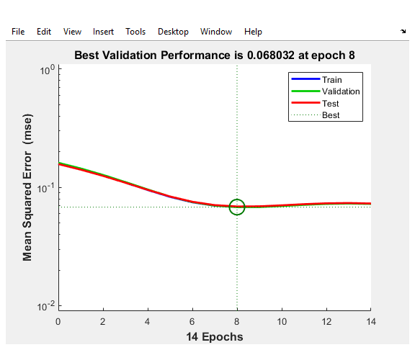
Choice of hyperparameters
The below parameters tuned using MATLAB using trainingdm function
No of neurons: Used were 3 as it provided best optimization. No of neurons when increased increased the training time and RSME .
Learning rate :Used was 0.05-0.8 some of the best learning was around the value.Too low-was leading too long trianing
Momentum rate was added so that network can pass through local minimum, which was 0.9 with best potimization
Mean Squared Error is used to test the performance of feed forward network

Slide 7
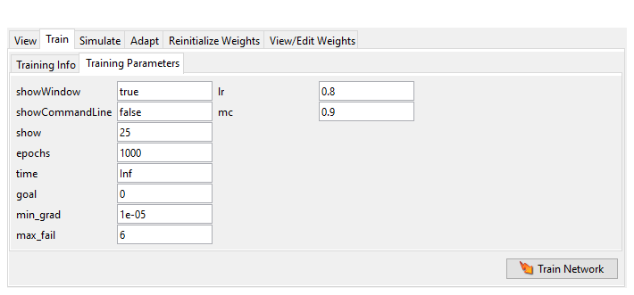
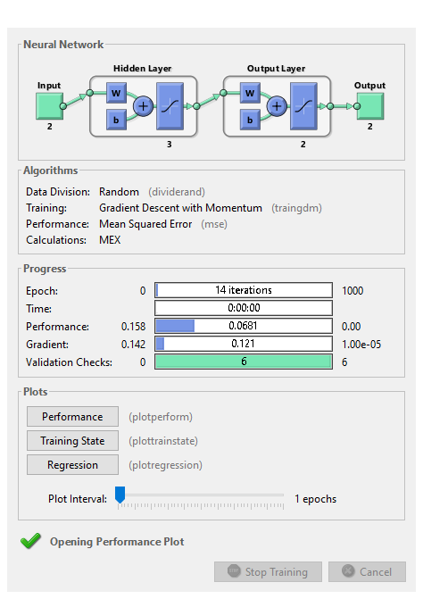
Epoch and Function used
The optimized values for LR and MU

Slide 8
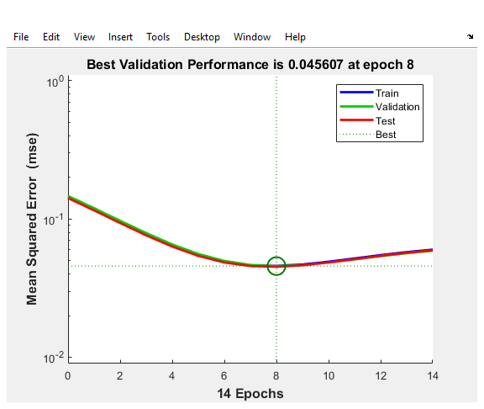
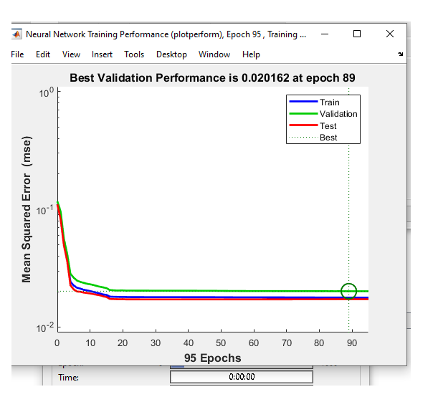

Slide 9
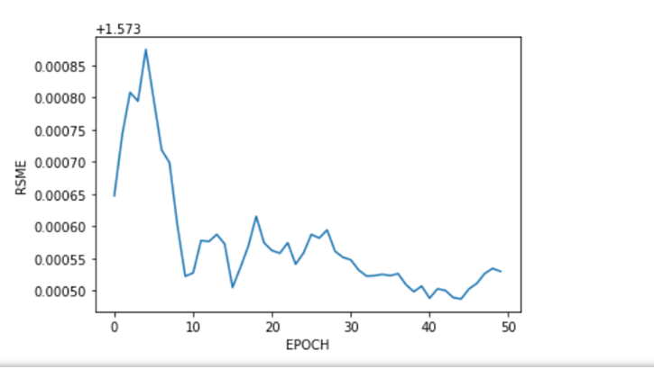
Stopping criteria
Epoch are stopped until stopping criteria is reached :
Weight changes are very small
Only converges for linearly seperable data
Decrease in performance for given number of epoch

Slide 10
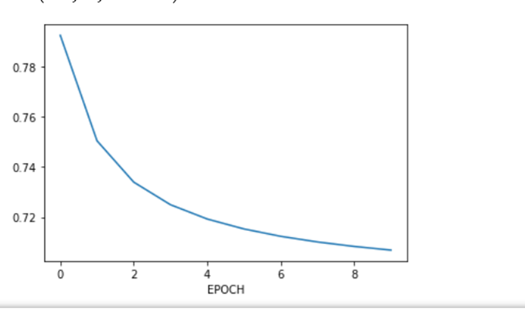
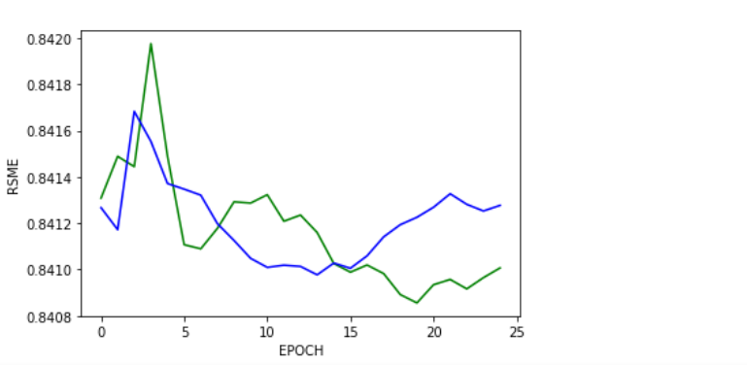
Root Mean Squared Error
RMSE is used to evaluate the quality of predicted values.
I ran RMSE on training data for different epochs.

Slide 11
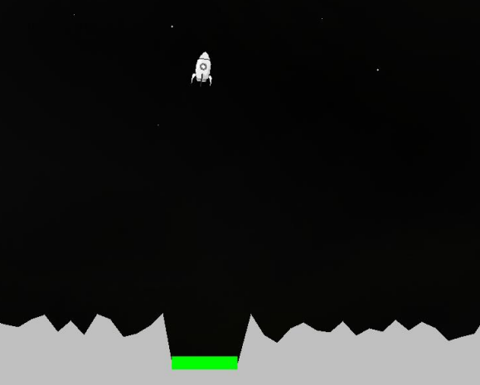
Conclusion
The lunar lander game was trained and tested over the test data and game integration was done in Neural net holder python to make the lander land.

Slide 12
https://www.google.com/search?q=multilayer+perceptron&rlz=1C1NDCM_enIN964IN964&sxsrf=ALiCzsad6Axb0wo4zrnMZsOClV87k4VR9A:1670837781110&source=lnms&tbm=isch&sa=X&ved=2ahUKEwjOia7j4_P7AhXNg1wKHaHTAU8Q_AUoAXoECAEQAw&biw=1163&bih=517&dpr=1.65#imgrc=2H6rtpCAkxZxXM
https://h2o.ai/wiki/multilayer-perceptron/
References

